Slide 1


Learning to Label and classify
From Clustering to Classification
Date: 18th May 2025
ePost Graduate Diploma (ePGD) in AI DS

Slide 2


Project Group Members
Dipen Thaker
Sujit Warrier
Sameer Chaudhary
Sanjay Jangid

Slide 3

Contents
1. Overview
3. Executive Summary
2. Project Stages
4. Present classification validation

Slide 4


Overview
The project aims to handle and process the given unlabeled and unclassified data, image and text, and extract relevant features and assign appropriate labels.
The assigned labels are extracted as Y_train
Here is the approach followed :
Data Preprocessing
Initial data exploration
Generate multiple random samples which each of 100 images and view those images as part of exploration
Read and dump the text data in a txt file
Reshape data. Dump data to CSV as matrix for viewing data
Prepare X_train for further processing
Text dataset:
• Dataset: 1500 unlabelled email threads (train_data_text.pkl) having 412+ words
• Cleaned using lowercase conversion, punctuation removal, and stop words filtering
Unsupervised Learning
Normalize data for un-biased PCA for image data
Perform PCA on various variance coverage for image data
Visualizing PCA components showed us that around 200 components were enough for further analysis. (Fig 1.1 & Fig 1.2)
Analysed various clustering techniques such as K-means, DB-Scan, Gaussian Mixture and HDBSCAN. Using t-SNE analysis with viewing clusters (See fig 1.3)
HDBSCAN and KMeans were selected for clustering.
Cluster on PCA data and extract labels (clusters), for image and text data sets
Extract labels (Y_train) for both image and text data sets
(Text) : • Tokenized into words and vectorized using TF-IDF (shape: 1500 × 1000)
Supervised Model Training
Train the model with X_train and Y_train for both image and text data
Check model’s train-accuracy, validation-accuracy, confidence and probabilities

Slide 5
Executive Summary
The aim of this project is to label unlabeled image and text data. Image data set contains 60K gray scale images and text data set contains a long email chain discussing few topics. Once the training is done, the project also aims to use a classifier of choice and train it using the labels generated
For this project we used multi-step project:
Data exploration and normalization
Feature extraction using PCA for 2 different variance coverage
K-Means* and HDBSCAN* for clustering
t-SNE for visualization of clusters
Use RandomForest* and KNearestNeighbour* classifiers and train them
Validate each classifiers against the test data obtained from external source
Plot 50 test images to check the model’s truth
For PCA analysis we used 2 variance coverages, of 75% and 95% respectively for feature extraction and used it for clustering so to check the respective Silhouette scores. We chose the highest Silhouette score among the combination
Once the clustering (labels) was done using KMeans* and HDBSCAN*, we used t-SNE to visualize the cluster division (Not viewing the clusters in color shows the boundary, if any, between clusters). This was more of a visual evaluation of clustering using different combination of variance coverages and K

Slide 6
Executive Summary
One of the difficulty we observed that the time taken in visualizing using t-SNE was more than 5 to 7 mins and hence we have not included the t-SNE code in the shared project code-artifact
Once the clusters/labels (Y_train) are extracted, we have trained 2 classifiers RandomForest* and KNearestNeighbour* on X_train and Y_train
Another difficulty we faced and observed was memory consumption and time taken for training using KNearestNeighbour is much more than that taken by RandomForest
Training both the classifiers, we used both RandomForest* and KNearestNeighbour* to test against new external gray scale 70K images. Again, the time taken by KNearestNeighbour is much more than that taken by RandomForest classifier
Model accuracy for both the models is captured
^{* User choice}

Slide 7
Executive Summary
We decided to plot and capture 50 test images with their respective predicted cluster number for visual validation of both the models
Based on the metrics various collected and visual inference of clusters as well of the output test images classified against their “correct” cluster, made us conclude that variance conclude that
Variance coverage of 75% which yields 34 components/features when clustered using K-Means
With 8 clusters and RandomForest classifier yields good prediction of test images to correct
cluster number, with relatively faster execution and lesser memory consumption
Unlabeled text data was preprocessed using standard NLP techniques (lowercasing, punctuation & stop words removal). TF-IDF vectorization was applied to convert cleaned text into numerical feature vectors (shape: 1500 × 1000)
KMeans clustering (n=5) was used to generate pseudo-labels for unsupervised topic grouping.
Multiple classifiers (SVM, Logistic Regression, Naive Bayes) were trained using these pseudo-labels.
SVM achieved the best performance with 92.3% accuracy on an 80/20 validation split.
Real-world test set revealed a drop (~40% accuracy), prompting future work on manual topic labeling for better generalization.
Details under each step followed for image and text classification is in upcoming slides

Slide 8
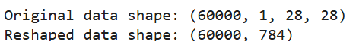
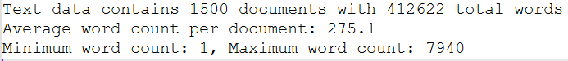
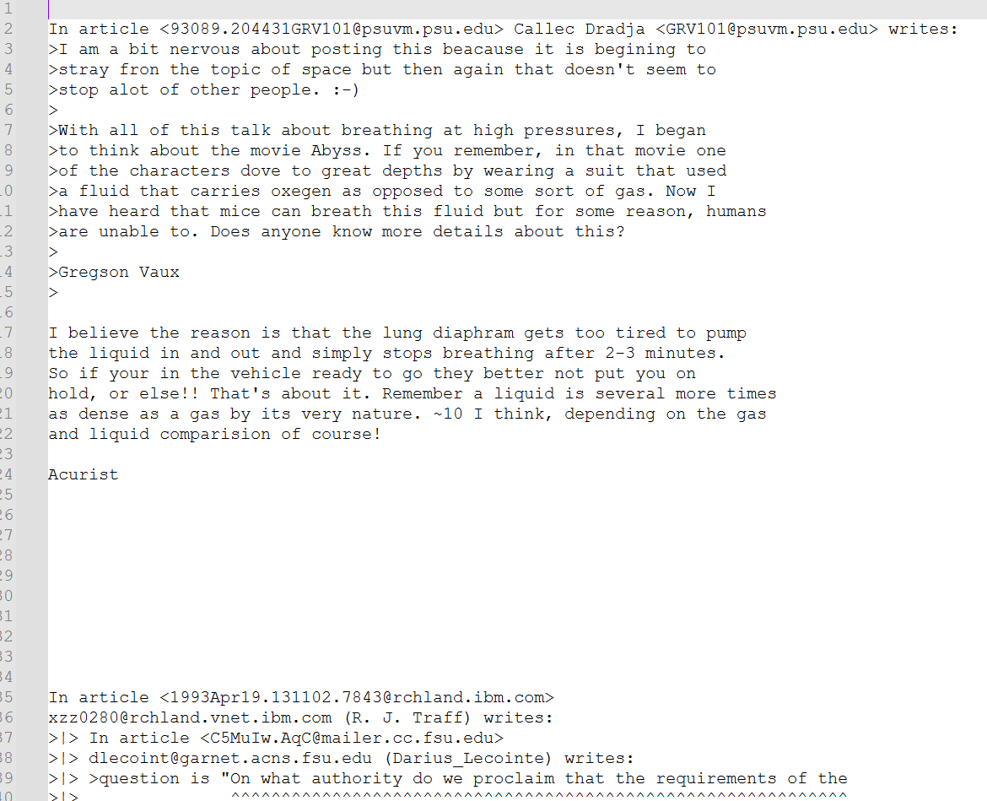
Data Processing
Import the data set so to visualize the data and look at its shape
Transform and flatten the image data to a readable/interpretable 2-dimensional format
The image data set is transformed to csv eliminating the channel layer
The text data set is transformed into a simple text file for viewing the content
Image Data Set
Text Data Set

Slide 9
Unsupervised learning
Normalize the data so to standardize it and remove any bias towards feature retention
Embed the data by retaining only the high-variance impacting features. This would reduce dimensions (Improving Speed, with almost no impact on accuracy, reducing memory usage and limited number of features covering maximum data variance)
Perform PCA on normalized data such that to give optimal number of features/components which covers 75% variance and again do PCA which covers 95% variance
75% variance coverage gave 34 components whereas 95% variance coverage gave 154 components
A plot for ‘explained variance coverage’ and a ‘scree’ which helped in deciding to pick from components for variance-coverage 75% or variance-coverage 95%
Train K-Means with cluster 8 and 10 so to cluster on PCA reduced data, for both the variance-coverage 75% and 95%
Look at t-SNE plots for 75%Variance+8Clusters, 75%Variance+10Clusters, 95%Variance+8Clusters and 95%Variance+10Clusters
Choose combination of clusters + variance-coverage giving maximum Silhouette Score
We have provided options for user to either choose K-MEANS or HDBSCAN for clustering
For text data, perform K-Means clustering

Slide 10
Unsupervised learning…
Below are the metrics, explained variance Vs PCA graphs, Silhouette Score and t-SNE plot based on various combination of clusters, variance coverage and the best is chosen so to generate the labels (Y_train)
Clusters = 8 and Variance Coverage = 95 | Clusters = 8 and Variance Coverage = 75
Clusters = 10 and Variance Coverage = 95 | Clusters = 10 and Variance Coverage = 75

Slide 11
Unsupervised learning…
Comparing Silhouette Score, looking at t-SNE graphs and model accuracy and model confidence, for below combinations, it was observed that there
From the above metric, PCA with 75% variance coverage and 8 clusters gives better validation accuracy for both the classifiers, however, both are very comparable but by the numbers, we chose variance coverage 75% with PCA=34, K=8 and RandomForestClassifier
PCA with Variance Coverage of 75% |  |  |  | PCA with Variance Coverage of 95%
K = 8 |  | K = 10 |  | K = 8 |  | K = 10
RandomForest | KNN | RandomForest | KNN | RandomForest | KNN | RandomForest | KNN
PCA Comps = 34 S Score = 0.1099 Train Accu = 1.00 Val Accu = 0.934 | PCA Comps = 34 S Score = 0.1099 Train Accu = 0.942 Val Accu = 0.9056 | PCA Comps = 154 S Score = 0.0992 Train Accu = 1.00 Val Accu = 0.9236 | PCA Comps = 154 S Score = 0.0992 Train Accu = 0.9366 Val Accu = 0.8997 | PCA Comps = 34 S Score = 0.0793 Train Accu = 1.00 Val Accu = 0.9327 | PCA Comps = 34 S Score = 0.0793 Train Accu = 0.9415 Val Accu = 0.9104 | PCA Comps = 154 S Score = 0.0653 Train Accu = 1.00 Val Accu = 0.9234 | PCA Comps = 154 S Score = 0.0653 Train Accu = 0.9386 Val Accu = 0.9087

Slide 12
RandomForest Classifier
Random Forest Classifier – Classification Report
Class | Precision | Recall | F1-Score | Support
0 | 0.98 | 0.99 | 0.99 | 6903
1 | 0.97 | 0.99 | 0.98 | 7877
2 | 0.98 | 0.96 | 0.97 | 6990
3 | 0.95 | 0.96 | 0.96 | 7141
4 | 0.99 | 0.77 | 0.86 | 6824
5 | 0.96 | 0.94 | 0.95 | 6313
6 | 0.97 | 0.99 | 0.98 | 6876
7 | 0.96 | 0.97 | 0.96 | 7293
8 | 0.96 | 0.93 | 0.94 | 6825
9 | 0.79 | 0.96 | 0.86 | 6958
Metric | Precision | Recall | F1-Score | Support
Accuracy |  |  | 0.95 | 70000
Macro Average | 0.95 | 0.94 | 0.94 | 70000
Weighted Average | 0.95 | 0.95 | 0.95 | 70000
Column1 | Pred 0 | Pred 1 | Pred 2 | Pred 3 | Pred 4 | Pred 5 | Pred 6 | Pred 7 | Pred 8 | Pred 9
True 0 | 6838 | 4 | 4 | 4 | 0 | 7 | 27 | 1 | 8 | 10
True 1 | 1 | 7785 | 33 | 11 | 6 | 1 | 7 | 16 | 3 | 14
True 2 | 39 | 37 | 6698 | 30 | 8 | 4 | 18 | 117 | 28 | 11
True 3 | 1 | 11 | 53 | 6854 | 0 | 59 | 7 | 50 | 73 | 33
True 4 | 8 | 42 | 5 | 1 | 5249 | 0 | 27 | 7 | 8 | 1477
True 5 | 18 | 6 | 1 | 109 | 4 | 5939 | 85 | 4 | 104 | 43
True 6 | 27 | 17 | 2 | 0 | 6 | 27 | 6792 | 0 | 5 | 0
True 7 | 4 | 58 | 46 | 1 | 10 | 1 | 0 | 7044 | 8 | 121
True 8 | 15 | 66 | 21 | 78 | 21 | 126 | 43 | 16 | 6348 | 91
True 9 | 23 | 27 | 4 | 94 | 23 | 12 | 4 | 76 | 50 | 6645
Table 2.2
Table 2.1

Slide 13
Logistic Regression
Logistic Regression - Classification Report
Class | Precision | Recall | F1-Score | Support
0 | 0.96 | 0.97 | 0.97 | 6903
1 | 0.95 | 0.98 | 0.96 | 7877
2 | 0.93 | 0.9 | 0.92 | 6990
3 | 0.91 | 0.91 | 0.91 | 7141
4 | 0.96 | 0.76 | 0.85 | 6824
5 | 0.91 | 0.89 | 0.9 | 6313
6 | 0.94 | 0.97 | 0.95 | 6876
7 | 0.93 | 0.94 | 0.93 | 7293
8 | 0.91 | 0.88 | 0.89 | 6825
9 | 0.76 | 0.92 | 0.84 | 6958
Metric | Precision | Recall | F1-Score | Support
Accuracy |  |  | 0.91 | 70000
Macro Average | 0.92 | 0.91 | 0.91 | 70000
Weighted Average | 0.92 | 0.91 | 0.91 | 70000
Model Performance: Confusion Matrix
Column1 | Pred 0 | Pred 1 | Pred 2 | Pred 3 | Pred 4 | Pred 5 | Pred 6 | Pred 7 | Pred 8 | Pred 9
True 0 | 6721 | 1 | 12 | 13 | 5 | 49 | 46 | 10 | 32 | 14
True 1 | 1 | 7714 | 41 | 21 | 5 | 16 | 6 | 24 | 38 | 11
True 2 | 53 | 65 | 6316 | 107 | 39 | 17 | 78 | 125 | 147 | 43
True 3 | 12 | 21 | 144 | 6497 | 2 | 179 | 24 | 64 | 137 | 61
True 4 | 17 | 57 | 25 | 8 | 5179 | 4 | 56 | 24 | 27 | 1427
True 5 | 54 | 18 | 36 | 217 | 30 | 5594 | 133 | 23 | 144 | 64
True 6 | 39 | 21 | 43 | 5 | 16 | 62 | 6649 | 4 | 24 | 13
True 7 | 18 | 56 | 67 | 21 | 15 | 7 | 2 | 6842 | 15 | 250
True 8 | 38 | 143 | 62 | 158 | 26 | 206 | 55 | 34 | 5996 | 107
True 9 | 27 | 38 | 13 | 100 | 62 | 36 | 4 | 196 | 47 | 6435
Table 1.2
Table 1.1

Slide 14
K Nearest Neighbors (KNN)
K-Nearest Neighbors (KNN) – Classification Report
Class | Precision | Recall | F1-Score | Support
0 | 0.98 | 0.99 | 0.98 | 6903
1 | 0.95 | 0.99 | 0.97 | 7877
2 | 0.98 | 0.95 | 0.97 | 6990
3 | 0.95 | 0.96 | 0.96 | 7141
4 | 0.98 | 0.79 | 0.88 | 6824
5 | 0.96 | 0.95 | 0.95 | 6313
6 | 0.97 | 0.99 | 0.98 | 6876
7 | 0.95 | 0.97 | 0.96 | 7293
8 | 0.97 | 0.92 | 0.95 | 6825
9 | 0.81 | 0.95 | 0.87 | 6958
Metric | Precision | Recall | F1-Score | Support
Accuracy |  |  | 0.95 | 70000
Macro Average | 0.95 | 0.95 | 0.95 | 70000
Weighted Average | 0.95 | 0.95 | 0.95 | 70000
Column1 | Pred 0 | Pred 1 | Pred 2 | Pred 3 | Pred 4 | Pred 5 | Pred 6 | Pred 7 | Pred 8 | Pred 9
True 0 | 6847 | 6 | 5 | 5 | 1 | 8 | 23 | 2 | 1 | 5
True 1 | 1 | 7806 | 28 | 2 | 10 | 0 | 4 | 14 | 1 | 11
True 2 | 49 | 67 | 6675 | 21 | 7 | 3 | 14 | 132 | 15 | 7
True 3 | 3 | 18 | 44 | 6881 | 1 | 70 | 5 | 45 | 47 | 27
True 4 | 5 | 58 | 3 | 1 | 5403 | 0 | 25 | 10 | 2 | 1317
True 5 | 19 | 7 | 4 | 109 | 2 | 5979 | 81 | 8 | 68 | 36
True 6 | 26 | 17 | 0 | 0 | 5 | 21 | 6805 | 0 | 2 | 0
True 7 | 3 | 89 | 19 | 2 | 14 | 2 | 0 | 7049 | 3 | 112
True 8 | 26 | 84 | 25 | 98 | 28 | 153 | 34 | 23 | 6277 | 77
True 9 | 22 | 23 | 7 | 90 | 26 | 14 | 4 | 102 | 38 | 6632
Table 3.2
Table 3.1

Slide 15
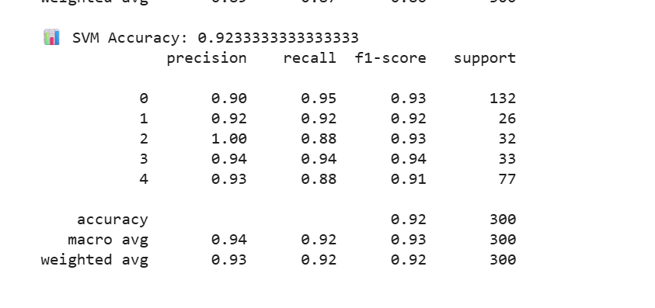
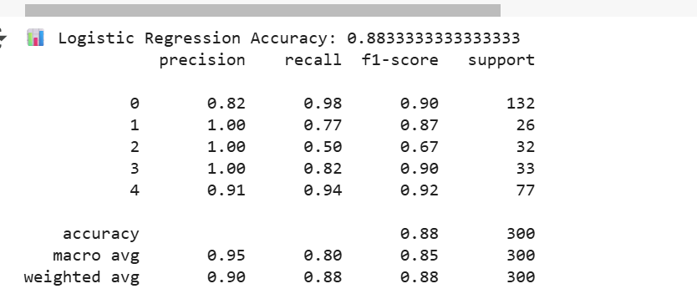
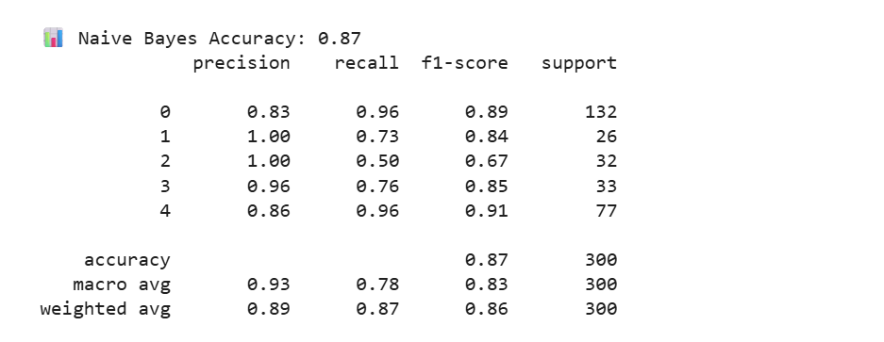
Text data model selection – SVM

Slide 16
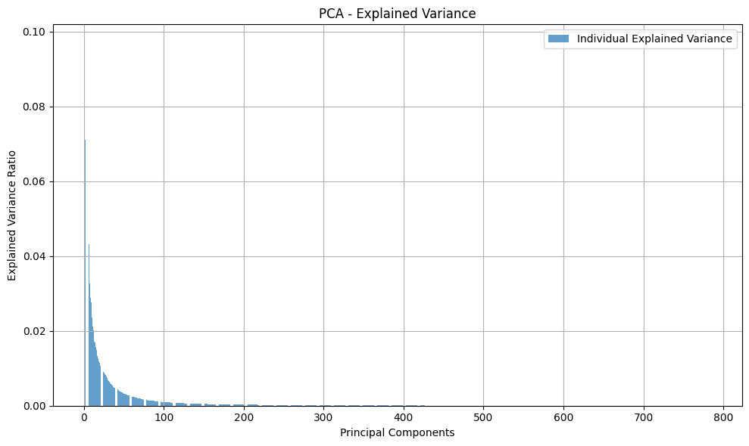
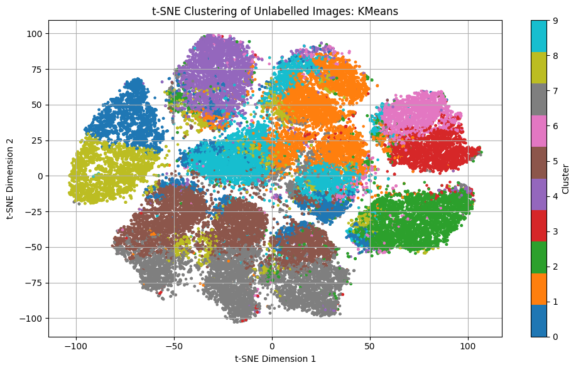
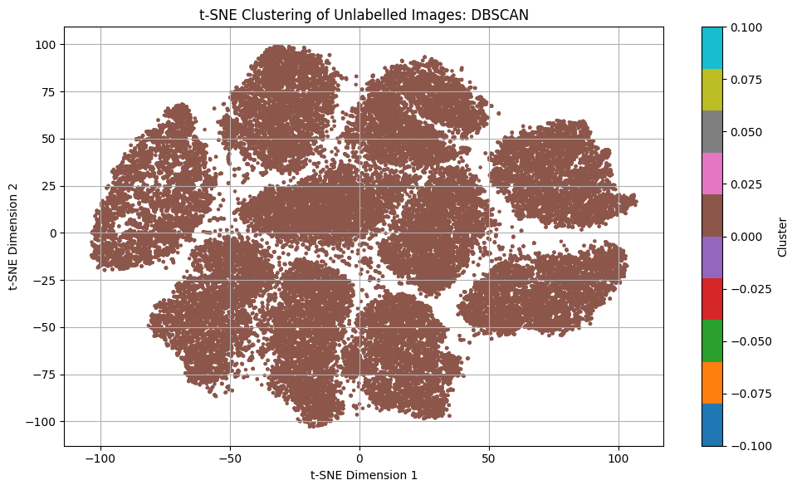
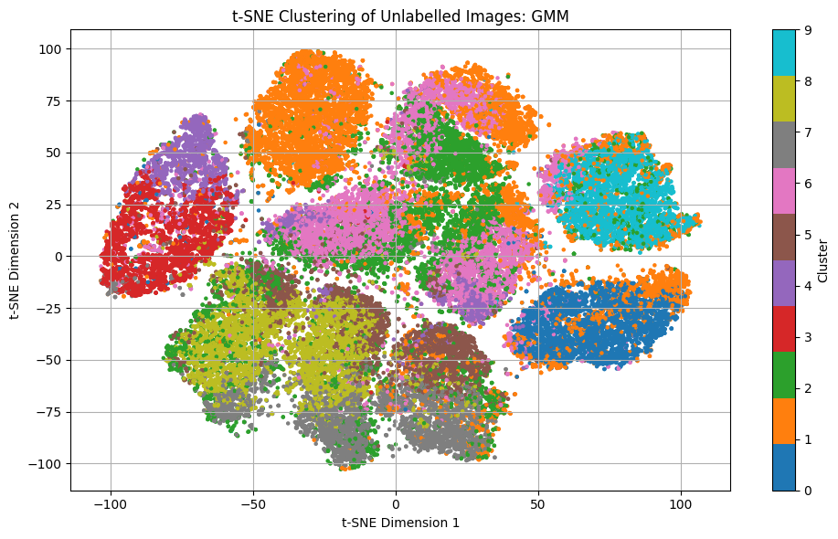
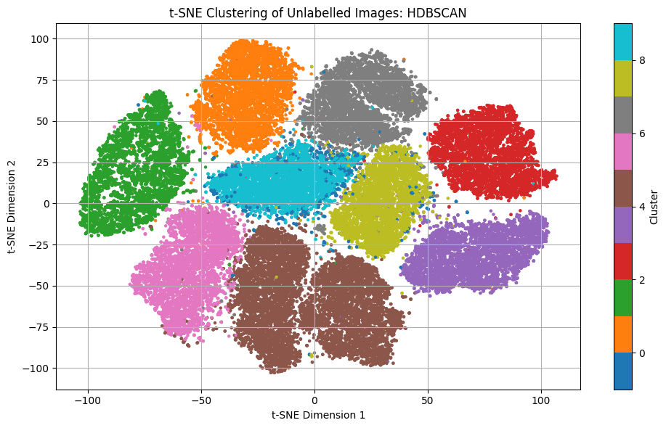
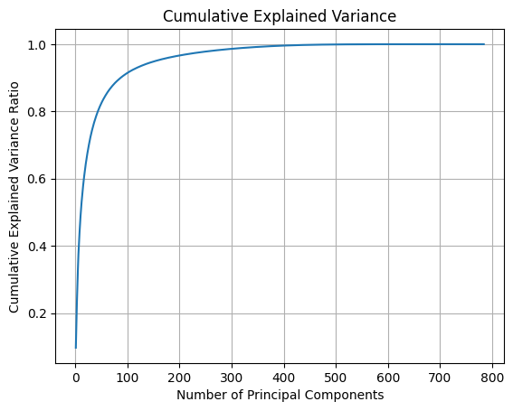
Test the image classifier models (RandomForest, KNN) against new gray scale images, not from provided input data
Test the text classifier models (RandomForest, LogisticRegression) against unseen text data , not from provided input data
Plot 50 testing images with cluster number to which it is classified, thus giving a meaning full completion to this project
Optionally, write the predicted text results in a txt file named ‘prediction_results.txt’
Fig 1.1 Explained variance in the data
Fig 1.2 Explained cumulative variance in the data
Fig 1.3 Comparison between various clustering techniques

Slide 17
Supervised learning
The aim of this project is to label the unlabeled image and text data set provided. Image data set has 60K gray scale images and text data set has a long email chain discussing few topics
For this project we tried some combinations, as below:
Training accuracy, validation accuracy, confidence and probabilities captured
Also, observed the execution time and memory consumption of both the classifiers

Slide 18
Model Evaluation and Testing(Image)
Obtaining new gray scale image data set of 70K images, for testing
Reshape the 70K test images
Predict against both the classifier models
Plot 50 sample test images with their respective predicted cluster number
Test model’s truth that it is predicting the test image to a cluster where the same and similar number looking images are grouped/clustered

Slide 19
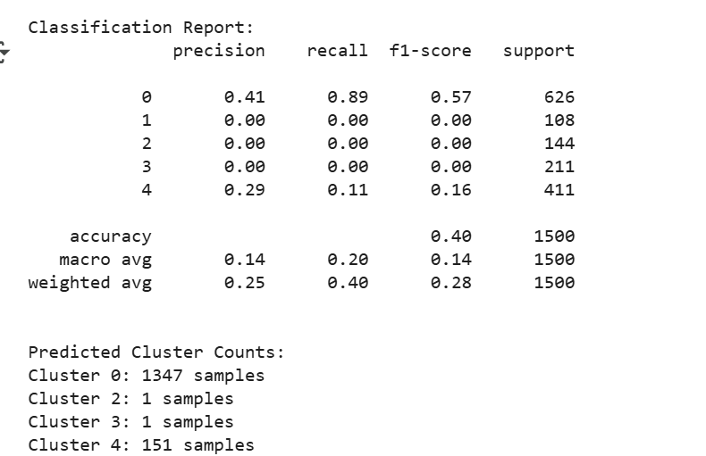
Model Evaluation and Testing(Text)
Model results on test:
Validation Set (80-20 from train_data_text.pkl):
→ Accuracy: 92.3%
• Real-world Test Set (stackexchange.txt):
→ Accuracy: ~40.0%
• Difference caused by noise in clustering-based labels
• Proposed improvement: use manually labelled topic data
Files Generated intermediate to while testing text classifier
• train_data_text.pkl – Training dataset
• stackexchange.txt – External test data
• tfidf_vectorizer.pkl – Saved vectorizer
• svm_model.pkl – Trained classifier
Evaluation_predict_text_cluster.py
To Test model:
Load the testing data txt file in the ‘evaluation_predict_text_cluster.py’ script provided in data files. On the commented area
Load files tfidf_vectorizer.pkl , svm_model.pkl
Run Evaluation_predict_text_cluster.py .
File will generate overall metrics like accuracy scores and cluster grouping for the given sentences in the test.text file
Test result on real time data set
.

Slide 20
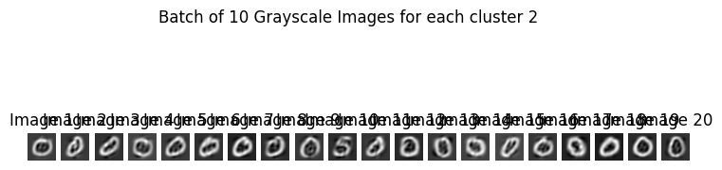
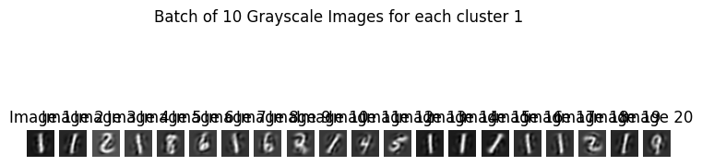
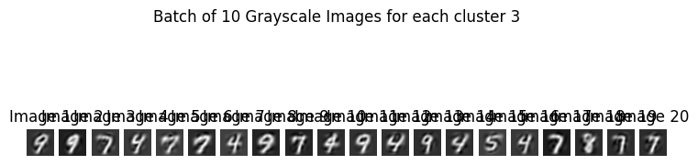
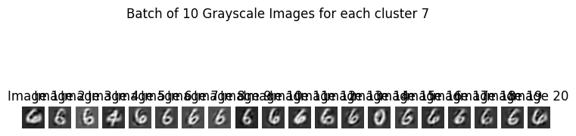
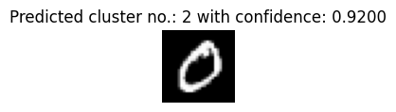
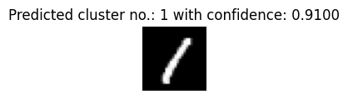

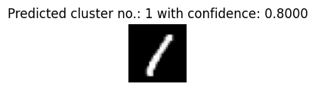
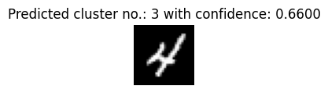

Present classification validation
RandomForest Classifier K=8, 75% Variance Coverage, PCA=34 | KNearestNeighbour Classifier K=8, 75% Variance Coverage, PCA=34

Slide 21

Thank You

